Slide 1
Computer
Organization & Design
The Hardware/Software Interface
施青松
Email: zjsqs@zju.edu.cn
2015-07-01
Notes:
1.1 Introduction

Slide 2
考试要求
闭卷
一页A4纸手写笔记
  期末考试为英文、闭卷，可带手写A4笔记一页(单面或双面)，包括图表均不可打印复印
  要求署名，不得互借，笔记与试卷一起上交
考试日期
  2015年07月09日(10:30-12:30)
  考试时间：120 分钟
考试地点：紫金港东1B-208 (多)

Slide 3
题型
试卷英文
有必要的图表提供
题型比率（参考样卷）：
  判断题：10分=10×1分
  选择题：20~40分=20×（1~2）分
  分析、计算、编程等：35-55分
  设计题：15分=1×15分

Slide 4
重点章节顺序
对课程的内容结构熟悉 重点
  第五章 数据通路与控制 1
  第二章 机器语言 2
  第七章 存储器层次 3
  第三章 算术运算 4
  第八章 输入输出 5
  第一章 概述

Slide 5
总则
教材：《Computer Organization & Design》3rd Edition
各章的Real Stuff不要求。
附录A：A.3、A.4、A.8、A.9不要求，A.10的部分指令可能会考。
附录B：逻辑门之前的内容(如触发器)不要求。
附录C：微程序控制器不要求。

Slide 6
主要知识点
章节 | 内容 | 备注
第一章 ：概论 第四章 ：性能 | 计算机历史 软硬件组成 性能评价 | CPI、MIPS、FLOPS RISC、CISC 每章的Fallacies&Pitfalls 每章的Real Stuff不要求
第二章 ：指令是硬件机器的语言——计算机指令系统 | 指令系统 汇编反汇编 算术、逻辑指令 转移指令、子程序 寻址方式 C语言手工编译 | 汇编指令转化成机器码(汇编) 机器码转化成汇编(反汇编) 典型指令：R-、LW、SW、BEQ、J、…其它参考附录A。 C语言程序、函数的手工编译，比如：strlen，strcpy，indexOf，数组求和、求最大最小等。
第三章 计算机中数的表示、转换与运算 | 数据表示 整数加减运算 整数乘除运算 浮点表示,加减运算 | 补码、移码、原码 整数加减算法分析、优化 加法器设计 乘、除算法分析。指令不要求 浮点数转换、四则运算。指令不要求

Slide 7
主要知识点
章节 | 内容 | 备注
第五章 ：处理器——数据通路与控制器的设计 | 单个组件设计 MIPS指令系统 ALU与ALU控制器 单时钟数据通道 多时钟数据通道 控制器设计 | 基本组件：MUX、译码器、扩展、…… 单时钟：增加指令 多时钟：增加指令 控制器、有限状态机(FSM)
第七章：存贮体系结构 | 存储器概论， 位扩展字扩展 Cache 虚拟存储 | SRAM、DRAM、刷新ROM/PROM/EPROM、 字位扩展 映射策略、TAG计算 替换策略、写策略、3C失配、平均时间 页表、TLB
第八章 ： 接口处理器和外部设备 | I/O概论 磁盘系统 总线系统、仲裁 数据通讯：轮询、中断、DMA | 以概念为主 磁盘计算 轮询中断DMA时间计算

Slide 8
Some Basic Concepts
Classes of Computer Applications and Their Characteristics
  Desktop computer
  Server
  Embedded computer
Five components of a Computer
  Control
  Datapath
  Input
  Output
  Memory

Slide 9
Design principles
  Simplicity favors regularity
  Smaller is faster
  Make the common case fast
  Good design demands good compromises
MIPS
  Byte addressing
  Alignment restriction
    Addresses of words are multiples of 4 in MIPS
  Pseudoinstruction
    Some variation of instructions can be treated as the common instructions as if they were instructions in their own right
  Spilling registers
    Putting less commonly used variables(or those needed later) into memory
Notes:
Simplicity favors regularity: 简单性来自规则性
1.1 Introduction

Slide 10
  Two key principles of today’s computers
Store-program
    Instructions are represented as numbers
    Programs can be stored in memory like numbers
Basic block
    A sequence of instructions without branches (except possibly at end) and without branch target or branch lables ( except possibly at the beginning )
Procedure/function be used to structure programs
    Six steps
    Caller: jal, pushes $a0~$a3 or $t0~$t9 to stack
    Callee: jr, pushes $ra (return address) and $s0~$s7 to stack
Software/hardware interface
Compiler allocates data structures to memory
Compiler associating variables with registers

Slide 11
Allocating Space for New Data on the Stack
  Procedure frame/activation record
    The segment of stack containing a procedure’s saved registers and local variables
  Frame pointer
    A value denoting the location of saved register and local variables for a given procedure
Allocating Space for New Data on the Heap

Slide 12
MIPS operands
Name | Example | Comment
32 registers | $s0-$s7,$t0-$t9. $zero,$a0-$a3,$v0-$v1, | Fast locations for data. In MIPS, data must be in registers to perform arithmetic. MIPS register $zero always equals 0. $gp(28) is the global pointer, $sp(29) is the stack pointer, $fp(30) is the frame pointer, and $ra(31) is the return address.
2³⁰ memory words | Memory[0] Memory[4]…… Memory[4294967292] | Accessed only by data transfer instructions. MIPS uses byte addresses, so sequential word addresses differ by 4. Memory holds data structures, arrays, and spilled registers, such as those saved on procedure calls.
Name | Register no. | Usage | Preserved on call
$zero | 0 | The constant value 0 | n,.a.
$v0-$v1 | 2-3 | Values for results and expression evaluation | no
$a0-$a3 | 4-7 | Arguments | no
$t0-$t7 | 8-15 | Temporaries | no
$s0-$s7 | 16-23 | Saved | yes
$t8-$t9 | 24-25 | More temporaries | no
$gp | 28 | Global pointer | yes
$sp | 29 | Stack pointer | yes
$fp | 30 | Framer pointer | yes
$ra | 31 | Return address | yes

Slide 13
MIPS assembly language p89
Category | Instruction | Example | Meaning | Comments
Arithmetic | add | Add $s1,$s2,$s3 | $s1=$s2 + $s3 | Three register operands
 | subtract | Sub $s1,$s2,$s3 | $s1=$s2－$s3 | Three register operands
Data transfer | load word | lw $1, 100($s2) | $s1=Memory[$s2+100] | Data from memory to register
 | store word | sw $s1, 100($s2) | Memory[$s2+100]=$s1 | Data from register to memory
logical | and | and $s1,$s2,$s3 | $s1=$s2 & $s3 | three reg. operands;bit-by-bit AND
 | or | or $s1,$s2,$s3 | $s1=$s2 | $s3 | three reg. operands;bit-by-bit OR
 | nor | nor $s1,$s2,$s3 | $s1=~($s2 | $s3) | three reg. operands;bit-by-bit NOR
 | and immediate | addi $s1,$s2,100 | $s1=$s2 & 100 | Bit-by-bit AND reg with constant
 | or immediate | ori $s1,$s2,100 | $s1=$s2 | 100 | Bit-by-bit OR reg with constant
 | shift left logical | sll $s1,$s2,10 | $s1=$s2 << 10 | Shift left by constant
 | shift right logical | srl $s1,$s2,10 | $s1=$s2 >> 10 | Shift right by constant
Conditional branch | branch on equal | beq $s1,$s2,L | If($s1==$s2) go to L | Equal test and branch
 | branch not eaqal | bne $s1,$s2,L | If($s1!=$s2) go to L | Not equal test and branch
 | set on less than | slt $s1,$s2,$s3 | If($s2<$s3) $s1=1 Else $s1=0 | Compare less than;used with beq, bne
 | set on less than immediate | slt $s1,$s2100 | If($s2<100) $s1=1 Else $s1=0 | Compare less than immediate; used with beq, bne
Uncondition-al jump | jump | j L | go to L | Jump to target address
 | jump register | jr $ra | go to $ra | For procedure return
 | jump and link | jal L | $ra=PC+4; go to L | For procedure call

Slide 14
MIPS machine language
Name | Format | Example |  |  |  |  |  | Comment
add | R | 0 | 18 | 19 | 17 | 0 | 32 | add $s1, $s2, $s3
sub | R | 0 | 18 | 19 | 17 | 0 | 34 | sub $s1, $s2, $s3
lw | I | 35 | 18 | 17 | 100 |  |  | lw $s1, 100($s2)
sw | I | 43 | 18 | 17 | 100 |  |  | sw $s1, 100($s2)
and | R | 0 | 18 | 19 | 17 | 0 | 36 | and $s1, $s2, $s3
or | R | 0 | 18 | 19 | 17 | 0 | 37 | or $s1, $s2, $s3
nor | R | 0 | 18 | 19 | 17 | 0 | 39 | nor $s1, $s2, $s3
addi | I | 12 | 18 | 17 | 100 |  |  | addi $s1, $s2,100
ori | I | 13 | 18 | 17 | 100 |  |  | ori $s1, $s2,100
sll | R | 0 | 0 | 18 | 17 | 10 | 0 | sll $s1, $s2,10
srl | R | 0 | 0 | 18 | 17 | 10 | 2 | srl $s1, $s2,10
beq | I | 4 | 17 | 18 | 25 |  |  | beq $s1, $s2,100
bne | I | 5 | 17 | 18 | 25 |  |  | bne $s1, $s2,100
slt | R | 0 | 18 | 19 | 17 | 0 | 42 | slt $s1, $s2,$s3
j | J | 2 | 2500 |  |  |  |  | j 10000(see section 2.9)
jr | R | 0 | 31 | 0 | 0 | 0 | 8 | j Sra
jal | J | 3 | 2500 |  |  |  |  | jar 10000(see section 2.9)
Field size |  | 6bits | 5bits | 5bits | 5bits | 5bits | 6bits | All MIPS instruction 32 bits
R-format | R | op | rs | rt | rd | shamt | funct | Arithmetic instruction format
i-format | I | op | rs | rt | address |  |  | Data transfer ,branch format

Slide 15
MIPS addressing mode summary
  Register addressing: add $s0,$s0,$s0
  Base or displacement addressing: lw $s1,0($s0)
  Immediate addressing: addi $s0,$s0,4
  PC-relative addressing: beq $s0,$s1,L1
  Pseudodirect addressing: j Address1
1
.
I
m
m
e
d
i
a
t
e
a
d
d
r
e
s
s
i
n
g
o
p
r
s
r
t
I
m
m
e
d
i
a
t
e
2
.
R
e
g
i
s
t
e
r
a
d
d
r
e
s
s
i
n
g
o
p
r
s
r
t
r
d
.
.
.
f
u
n
c
t
R
e
g
i
s
t
e
r
s
R
e
g
i
s
t
e
r
3
.
B
a
s
e
a
d
d
r
e
s
s
i
n
g
M
e
m
o
r
y
o
p
r
s
r
t
A
d
d
r
e
s
s
R
e
g
i
s
t
e
r
+
B
y
t
e
H
a
l
f
w
o
r
d
W
o
r
d
4
.
P
o
C
-
r
e
l
a
t
i
v
e
a
d
d
r
e
s
s
i
n
g
M
e
m
o
r
y
p
r
s
r
t
A
d
d
r
e
s
s
P
C
+
W
o
r
d
5
.
P
s
e
u
d
o
d
i
r
e
c
t
a
d
d
r
e
s
s
i
n
g
M
e
m
o
r
y
o
p
A
d
d
r
e
s
s
P
C
W
o
r
d

Slide 16
Summary of MIPS architecture in Chapter 2 P105
MIPS instruction format
| Name | Fields | Comments |
| Field size | 6 bits| 5 bits| 5 bits| 5 bits| 5 bits| 6 bits| All MIPS instructions 32 bits |
| R-format | op | rs | rt | rd |shamt| funct | Arithmetic instruction format |
| I-format | op | rs | rt | address/immediate | Transfer,branch,imm. format |
| J-format | op | target address | Jump instruction format |
MIPS operands
| Name | Example |
| 32 registers | $s0~$s7, $t0~$t9,$zero, $a0~$a3, $v0~$v1, $gp $fp, $gp, $ra, $at |
| Mem words | Memory[0], Memory[4], . . . , Memory[4294967292] |
MIPS assembly language
  Arithmetic
  Data transfer
  Conditional branc
  Unconditional jump

Slide 17
Number types
Integer numbers, unsigned
  Address calculations
  Numbers that can only be positive
Signed numbers
  Positive
  Negative
Floating point numbers
  numeric calculations
  Different grades of precision
    Singe precision (IEEE)
    Double precision (IEEE)
    Quadruple precision
in MIPS:
  Least significant bit is right (bit 0)
  Most significant bit is left (bit 31)

Slide 18
Number formats
Sign and magnitude
2's complement
1's complement
similar to 2's complement, + 0 & - 0
Biased notation
1000 0000 = minimal negative value(-2⁷)
0111 1111 = maximal positive value (2⁷-1)
Representation
  Binary
  Decimal
  Hexadecimal

Slide 19
More common: use of 2's complement
---- negatives have one additional number
  (0000 0000 0000 0000 0000 0000 0000 0000)₂ =(0)₁₀
  (0000 0000 0000 0000 0000 0000 0000 0001)₂ =(1)₁₀
  ………… ………
  (0111 1111 1111 1111 1111 1111 1111 1101)₂ =( 2，147，483，645)₁₀
  (0111 1111 1111 1111 1111 1111 1111 1110)₂ =( 2，147，483，646)₁₀
  (0111 1111 1111 1111 1111 1111 1111 1111)₂ =( 2，147，483，647)₁₀
  (1000 0000 0000 0000 0000 0000 0000 0000)₂ =(-2，147，483，648)₁₀
  (1000 0000 0000 0000 0000 0000 0000 0001)₂ =(-2，147，483，647)₁₀
  (1000 0000 0000 0000 0000 0000 0000 0010)₂ =(-2，147，483，646)₁₀
  ………… ………
  (1111 1111 1111 1111 1111 1111 1111 1101)₂ =(-3)₁₀
  (1111 1111 1111 1111 1111 1111 1111 1110)₂ =(-2)₁₀
  (1111 1111 1111 1111 1111 1111 1111 1111)₂ =(-1)₁₀

Slide 20
sign extension (lbu vs. lb)
Expansion
e.g. 16 bit numbers to 32 bit numbers
Required for operations with registers(32 bits) and immediate operands (16 bits)
Sign extension
  Take the lower 16 bits as they are
  Copy the highest bit to the remaining 16 bits
  0000 0000 0000 0010 → 2
  0000 0000 0000 0000 0000 0000 0000 0010
  1111 1111 1111 1110 → -2
  1111 1111 1111 1111 1111 1111 1111 1110

Slide 21
Arithmetic
Addition and Subtraction
Logical operations
Constructing a simple ALU
Multiplication
Division
Floating point arithmetic
Adding all parts to get an ALU

Slide 22
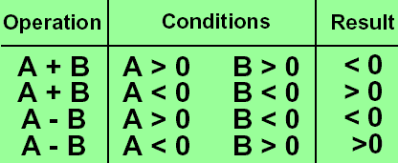
Overflow
The sum of two numbers can exceed any representation
The difference of two numbers can exceed any representation
2's complement:
  Numbers change
  sign and size
General overflow conditions
Overflow process?
Which instructions cause Overflow?

Slide 23
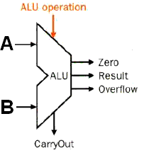
ALU symbol & Control
Symbol of the ALU
Control：Function table
ALU Control Lines | Function
000 | And
001 | Or
010 | Add
110 | Sub
111 | Set on less than

Slide 24
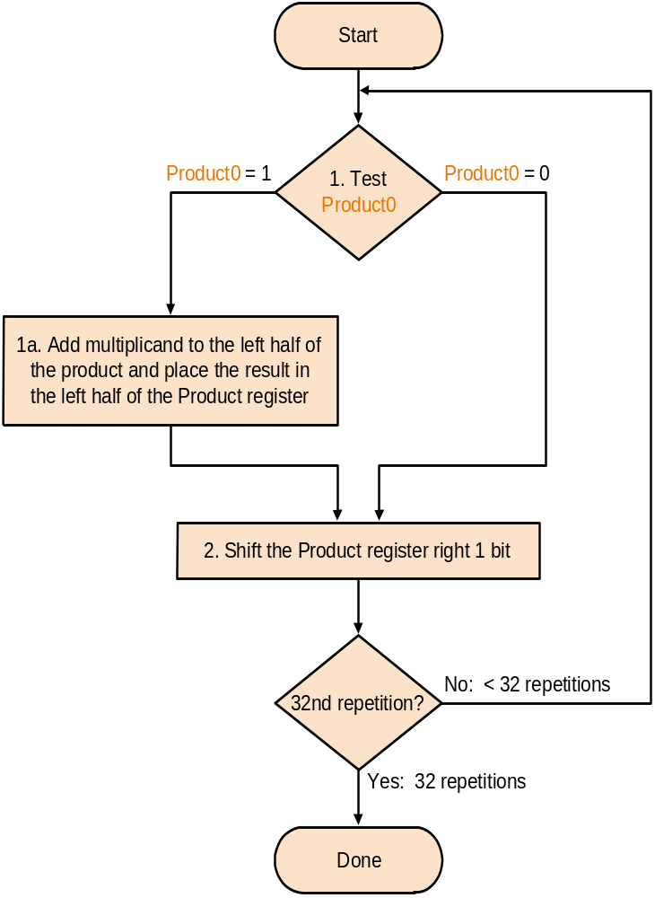
Multiplier V3--Algorithmic rule
Set product register to '0'
Load lower bits of product
register with multiplier
Test least significant bit
of product register

Slide 25
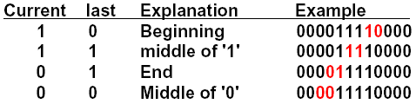
Booth's Algorithm rule
Analysis of two consecutive bits
Action
      1 0 subtract multiplicand from left
      1 1 no arithmetic operation
      0 1 add multiplicand to left half
      0 0 no arithmetic operation
Bit₋₁ = '0'
Arithmetic shift right:
  keeps the leftmost bit constant
  no change of sign bit !

Slide 26
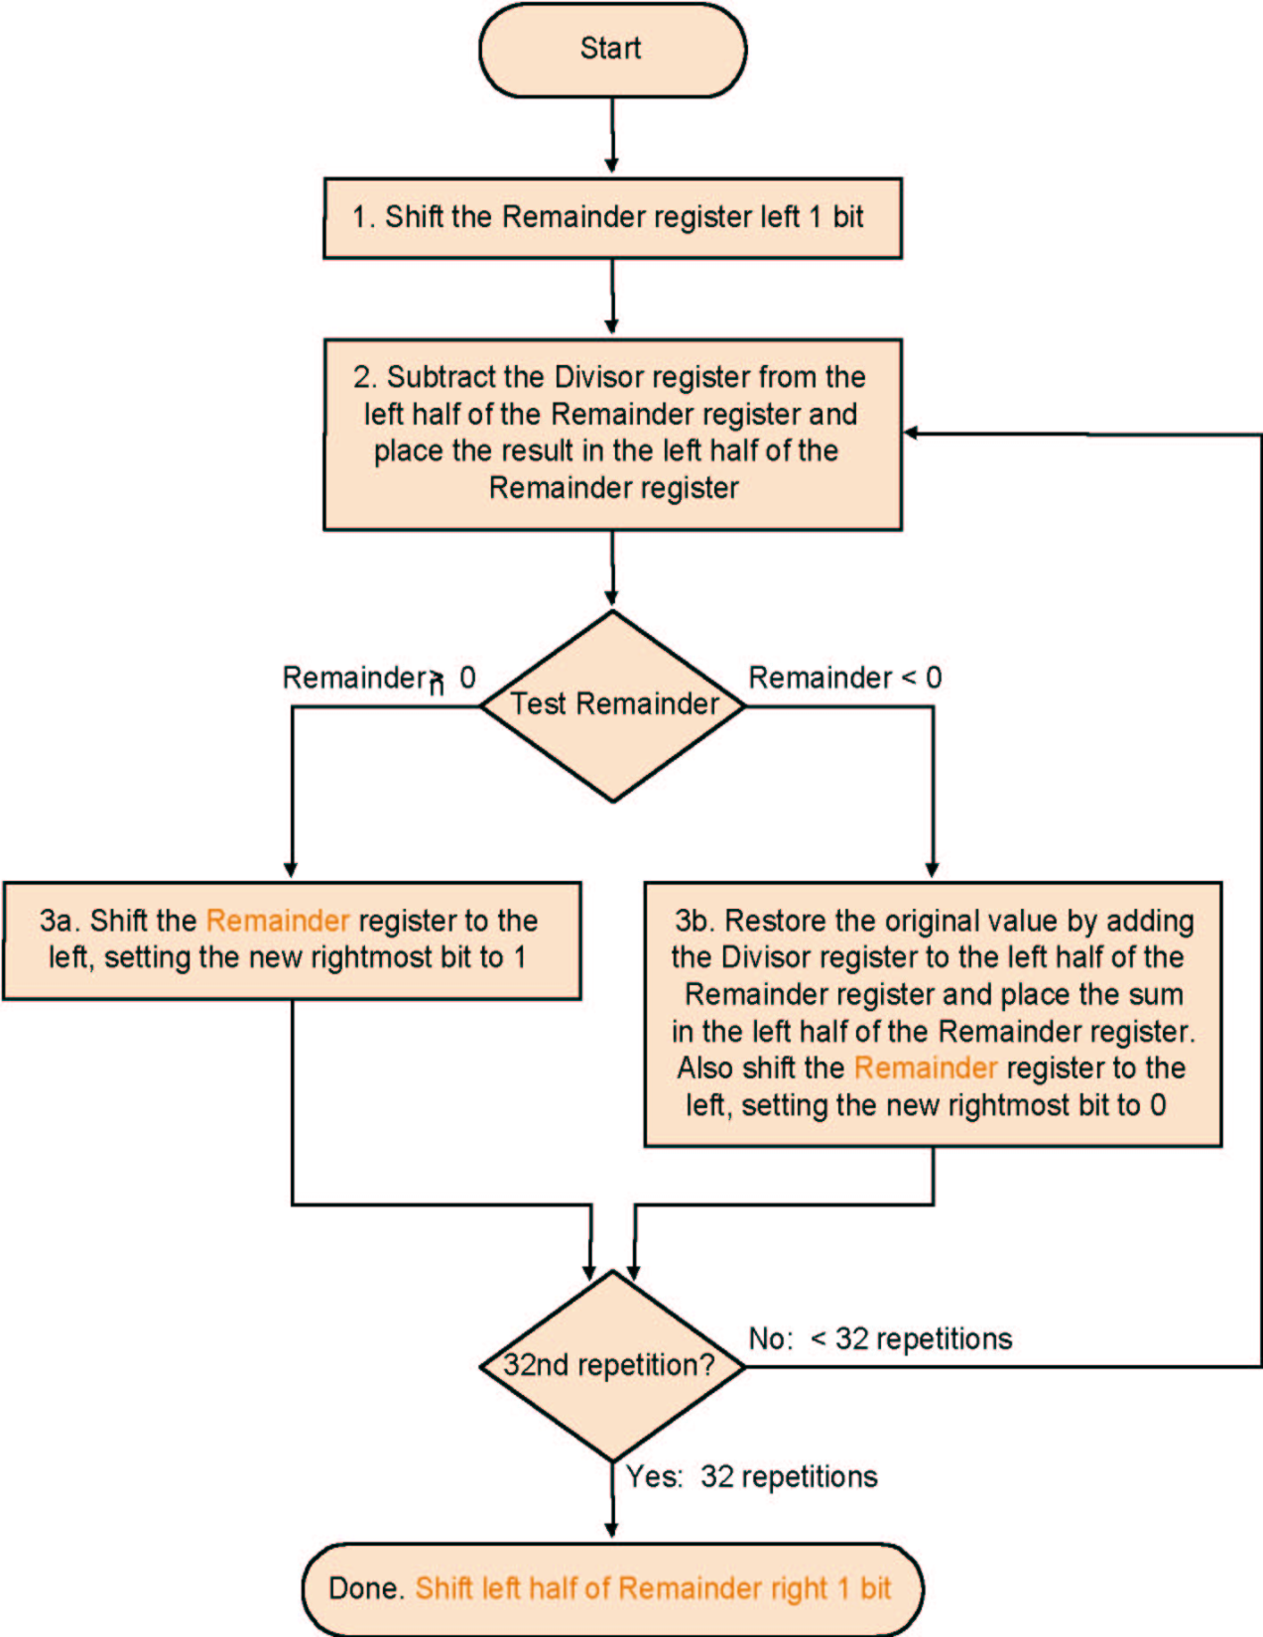
Algorithm V 3
Much the same than the last one
Except change of register usage
Singed: Keep the signs in mind for Dividend and Remainder
One 64 bit register : Hi & Lo
  Hi: Remainder, Lo: Quotient

Slide 27
Floating point numbers
Form
  Arbitrary 363.4 • 10³⁴
  Normalised 3.634 • 10³⁶
Binary notation
  Normalised 1.xxxxxx • 2^{yyyyy}
Standardised format IEEE 754
  Single precision 8 bit exp, 23 bit significand
  Double precision 11 bit exp, 52 bit significand
Both formats are supported by MIPS
31 | 30 …… 23 | 22 …… 0
S | exponent | fraction
1 bit | 8 bits | 23 bits
Single precision
31 | 30 …… 20 | 19 …… 0
S | exponent | fraction
1bit | 11 bits | 20 bits
31 fraction (continued) 0
Double precision
32 bits

Slide 28
IEEE 754 standard
Leading '1' bit of significand is implicit
->saves one bit
Exponent is biased:
00...000 smallest exponent
11...111 biggest exponent
  Bias 127 for single precision
  Bias 1023 for double precision
Rounding: four rounding modes
Summary:
(-1)^{sign} • (1 + significand) • 2^{exponent - bias}

Slide 29
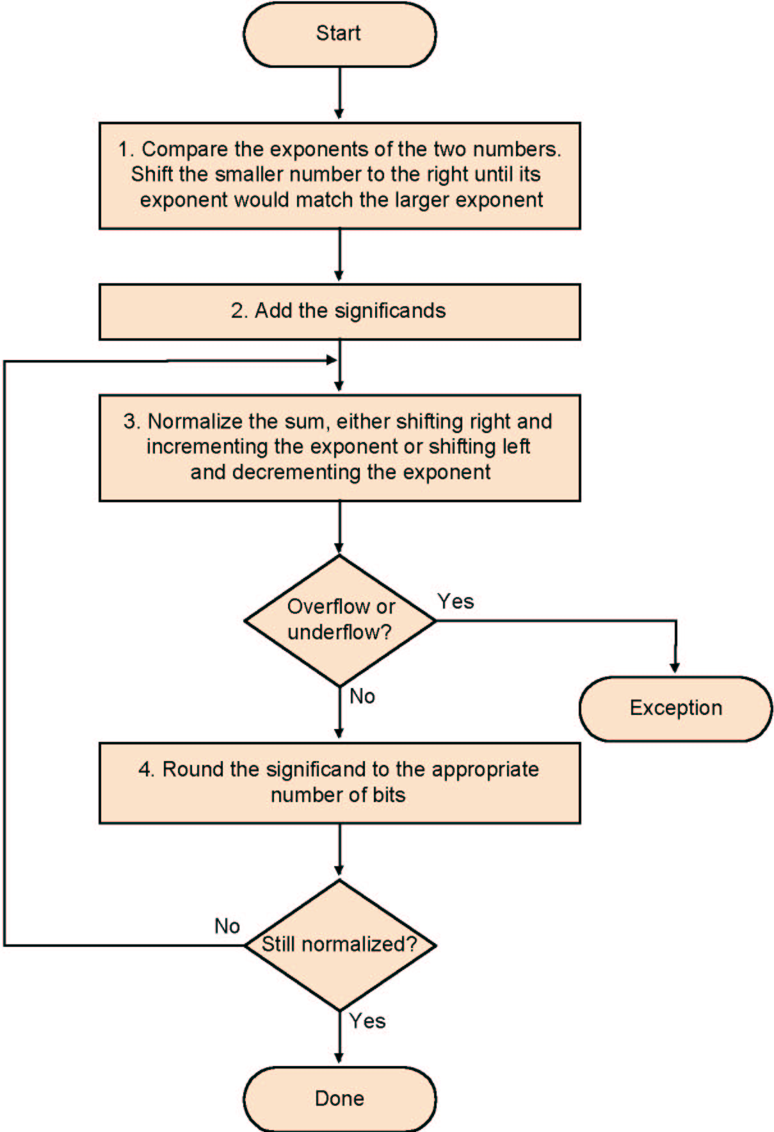
Floating point addition
Alignment
The proper digits have to be added
Addition of significands
Normalisation of the result
Rounding

Slide 30
Multiplication Division-- Brief
Add exponents
Multiply the significands
Normalise
Over- underflow
Rounding
Sign
Subtraction of exponents
Division of the significants
Normalisation
Runding
Sign

Slide 31
Datapath and Control
Logic Circuit
  combinational logic:
    a type of digital logic which is implemented by boolean circuits, where the output is a pure function of the present input only without memory.
  sequential logic
    the output depends not only on the present input but also on the history of the input. In other words with memory
      Write register in single cycle design

Slide 32
Instruction execution in MIPS
Fetch :
  Take instructions from the instruction memory
  Modify PC to point the next instruction
Instruction decoding & Read Operand:
  Will be translated into machine control command
  Reading Register Operands, whether or not to use
Executive Control:
  Control the implementation of the corresponding ALU operation
Memory access:
  Write or Read data from memory
  Only LW/SW
Write results to register:
  If it is R-type instructions, ALU results are written to Rd
  If it is I-type instructions, Results are written to Rt

Slide 33
signals for datapath of Multicycle Defined 10+6 control (p. 324)
Signal name | Effect when deasserted(=0) | Effect when asserted(=1)
RegDst | Select register destination number from the rt(20:16) when WR. | Select register destination number from the rd(15:11) when WB.
RegWrite | None | Register destination input is written with the value on the Write data input
ALUScrA | The first ALU operand is the PC | The first ALU operand come from the A register.
MemRead | None | Memory contents at the location specified by the address input is put on the Memory data out.
MemWrite | None | Memory contents at the location specified by the address input are replaced by value on the Write data input.
MemtoReg | The value fed to register Write data input comes from the ALUOut | The value fed to the register Write data input comes from the MDA.
IorD | The PC is used to supply the address to the memory unit. | ALUOut is used to supply the address to the memory unit.
IRWrite | None | The output of memory is written into the IR.
PCWrite | None | The is written;the source is controlled by PCSource.
PCWriteCond | None | The PC is written if the zero output from the ALU is also active.

Slide 34
Control signals
Signal name | Value | Effect
ALUOp | 00 | The ALU performs an add operation.
 | 01 | The ALU performs an subtract operation.
 | 10 | The funct field of the instruction determines the ALUoperation
ALUScrB | 00 | The second input to the ALU comes from the B register.
 | 01 | The second input to the ALU is the constant 4.
 | 10 | The second input to the ALU is the sign-extended, lower 16 bits of the IR.
 | 11 | The second input to the ALU is the sign-extended, lower 16 bits of the IR shift 2 bits.
PCSource | 00 | Output of the ALU(PC+4) is sent to the PC for writing.
 | 01 | The contents of ALUOut (the branch target address) are sent to the PC writing.
 | 10 | The jump target address (IR[25:0]shifted left 2 bits and concatenated with PC+4[31:28]) is sent to the PC for writing.

Slide 35
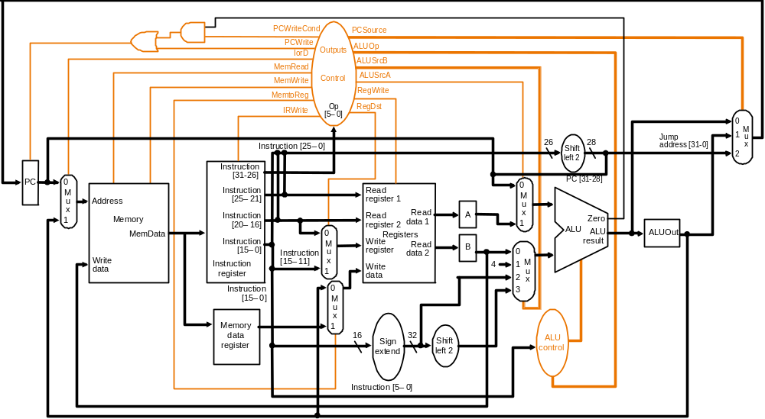
  seq: pc = pc + 4
  beq：pc = pc + offset * 4
  j ：pc = pc₃₁₋₂₈ + IR₂₅₋₀ << 2

Slide 36
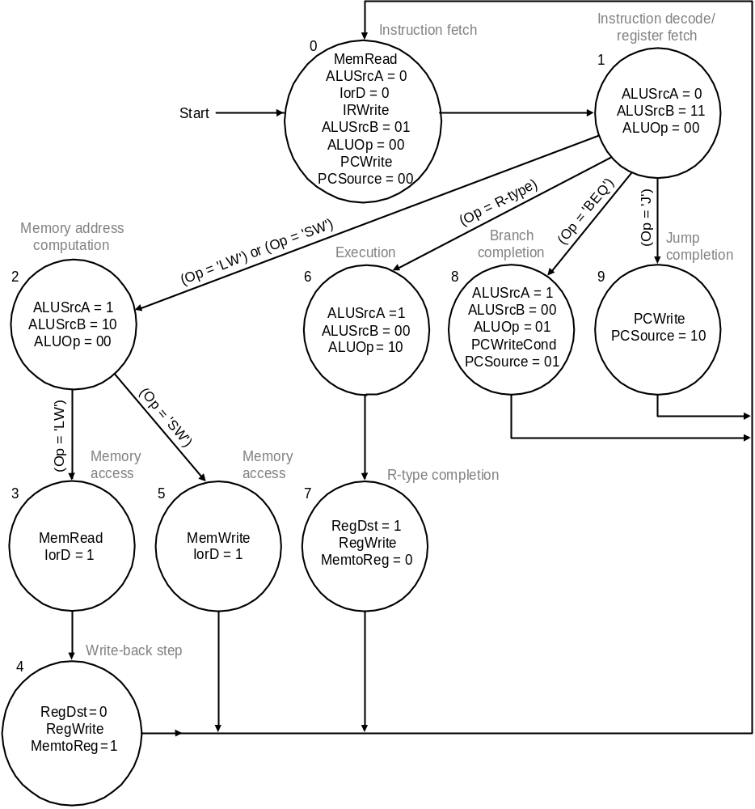
Graphical Specification of FSM
jump
sw
beq
lw
R-type

Slide 37
Microinstruction format
Microinstruction
  control signal
  position of next Microinstruction
Representation
  split into some fields
  next position
    sequential
    dispatch table (jump)

Slide 38
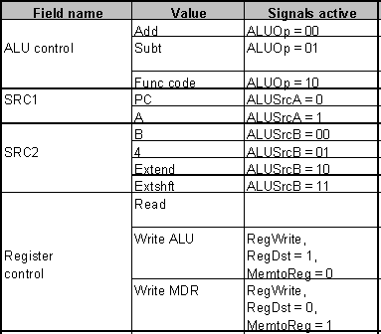
Microinstruction format
(Reg fetch)
A=Reg[IR₂₅₋₂₁], B=Reg[IR₂₀₋₁₆]

Slide 39
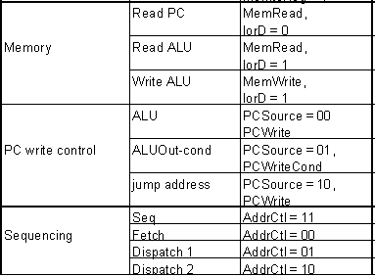
Microinstruction format
Mem address is from

Slide 40
Microoperation

Slide 41
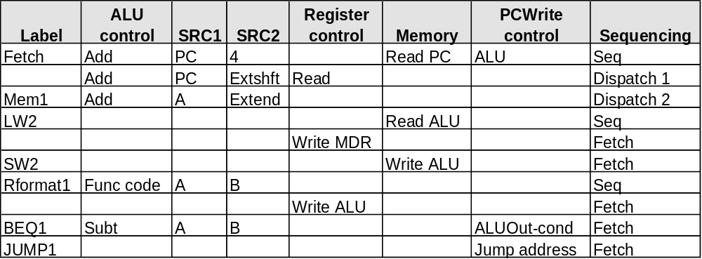
Microprogramming
A specification methodology
  appropriate if hundreds of opcodes, modes, cycles, etc.
  signals specified symbolically using microinstructions
address
0000
0001
0010
0011
0100
0101
0110
0111
1000
1001

Slide 42
微指令编码
ALU | 0 | 0 | 0 | 0 | 0 | 0 | 1 | 0 | 0 | 0 | ALUOp1
 | 0 | 0 | 0 | 0 | 0 | 0 | 0 | 0 | 1 | 0 | ALUOp0
SRC1 | 0 | 0 | 1 | 0 | 0 | 0 | 1 | 0 | 1 | 0 | ALUSrcA
SRC2 | 0 | 1 | 1 | 0 | 0 | 0 | 0 | 0 | 0 | 0 | ALUSrcB1
 | 1 | 1 | 0 | 0 | 0 | 0 | 0 | 0 | 0 | 0 | ALUSrcB0
Register control | 1 | 0 | 0 | 0 | 0 | 0 | 0 | 0 | 0 | 0 | IRWrite
 | 0 | 0 | 0 | 0 | 1 | 0 | 0 | 1 | 0 | 0 | RegWrite
 | 0 | 0 | 0 | 0 | 0 | 0 | 0 | 1 | 0 | 0 | RegDst
 | 0 | 0 | 0 | 0 | 1 | 0 | 0 | 0 | 0 | 0 | MemtoReg
Memory control | 1 | 0 | 0 | 1 | 0 | 0 | 0 | 0 | 0 | 0 | MemRead
 | 0 | 0 | 0 | 0 | 0 | 1 | 0 | 0 | 0 | 0 | MemWrite
 | 0 | 0 | 0 | 1 | 0 | 1 | 0 | 0 | 0 | 0 | IorD
PCWite | 0 | 0 | 0 | 0 | 0 | 0 | 0 | 0 | 0 | 1 | PCSource1
 | 0 | 0 | 0 | 0 | 0 | 0 | 0 | 0 | 1 | 0 | PCSource0
 | 1 | 0 | 0 | 0 | 0 | 0 | 0 | 0 | 0 | 1 | PCWrite
 | 0 | 0 | 0 | 0 | 0 | 0 | 0 | 0 | 1 | 0 | PCWriteCond
Seq | 1 | 0 | 1 | 1 | 0 | 0 | 1 | 0 | 0 | 0 | Addrctl1
 | 1 | 1 | 0 | 1 | 0 | 0 | 1 | 0 | 0 | 0 | Addrctl0
Sequencing
Dispatch 1
Dispatch 2
Fetch
Fetch
Fetch
Fetch
Seq
Seq
Fetch
Seq
PCWrite
Jump address
control
ALUOut-cond
ALU
Read ALU
Memory
Write ALU
Read PC
Register
Write MDR
control
Write ALU
Read
SRC2
Extend
Extshft
B
4
B
SRC1
PC
PC
A
A
A
ALU
control
Func code
Add
Subt
Add
Add
Label
Rformat1
Mem1
JUMP1
Fetch
BEQ1
SW2
LW2

Slide 43
Exception
Exception
  An Exception is a unexpected event from within processor.
We follow the MIPS convention, using the term exception to refer to any unexpected change in control flow.
Here we will discuss two types exceptions :
  arithmetic overflow
  undefined instruction
How Exceptions Are Handled
How Control Checks for Exceptions

Slide 44
Locality---- two important concepts
1. temporal locality (locality in time): If an item is referenced, it will tend to be referenced again soon.
2. spatial locality (locality in space): If an item is referenced, items whose addresses are close by will tend to be referenced soon.
hit: The CPU accesses the upper level and succeeds.
Miss: The CPU accesses the upper level and fails.
Hit time: The time to access the upper level of the memory hierarchy, which includes the time needed to determine whether the access is a hit or a miss.
miss penalty: The time to replace a block in the upper level with the corresponding block from the lower level, plus the time to deliver this block to the processor.

Slide 45
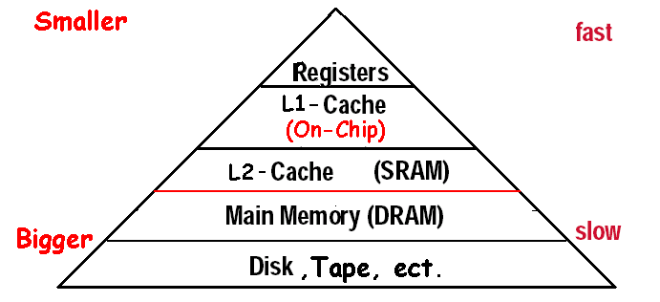
Exploiting Memory Hierarchy
The method
  Hierarchies bases on memories of different speeds and size
  The more closely CPU the level is,the faster the one is.
  The more closely CPU the level is,the smaller the one is.
  The more closely CPU the level is,the more expensive
Levels in the memory hierarchy
Increasing distance form the CPU in access time
Size of the memory at each level

Slide 46
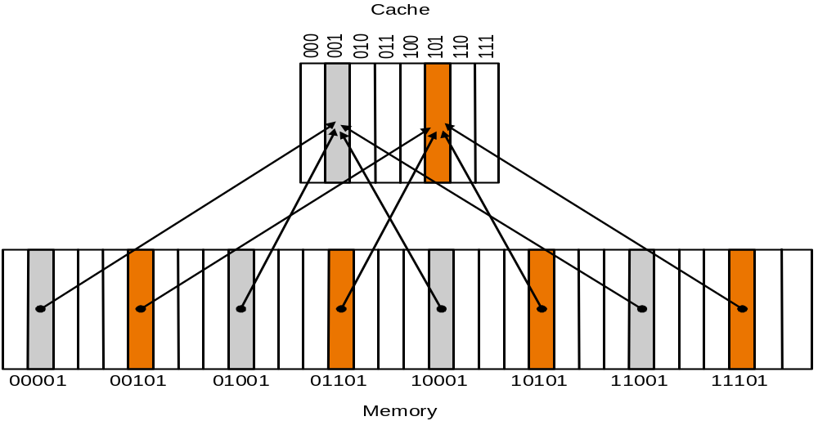
Direct Mapped Cache
Where can a block be placed in the upper level?
index
8 Block
Direct-mapping algorithm.
  memory address is modulo the number of blocks in the cache

Slide 47
Accessing a cache---how do we find it?
Memory block address is larger than cache block address
TAG
Index
Byte offset
Block address MOD Numbers of Cache Block
Index | V | Tag | Data
000 | N
001 | N
010 | N
011 | N
100 | N
101 | N
110 | N
111 | N
a. The initial state of the cache after power-on
valid bit

Slide 48
Mapping an Address to Multiword Cache Block
Handling Cache reads hit and Misses
Read misses—two kinds of misses
  instruction cache miss
  data cache miss
  The process of miss handle
Write hits: Difference Strategy
  write-back:Wrote the data into only the data cache
  write-through: Write the data into both the memory the cache
Write misses
  read the entire block into the cache, then write the word
Byte address
×Byte per block
Byte address
+( Byte per block-1)
Bytes per block
Bytes per block
×Byte per block

Slide 49
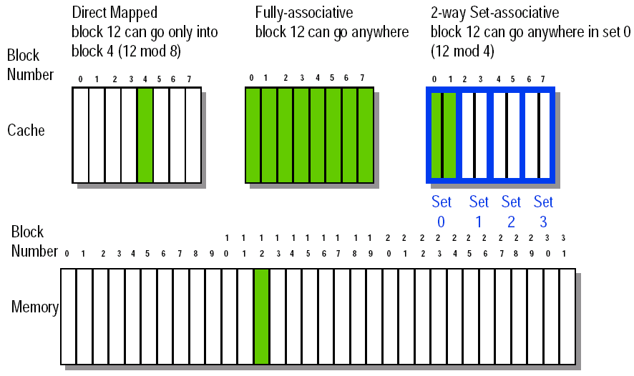
Cache size and associativity are not independent in determining cache performance
Increasing block size to reduce capacity misses

Slide 50
Block Placement
Direct mapped : Block can only go in one place in the cache , Usually address MOD Number of blocks in cache
Fully associative: Block can go anywhere in cache.
Set associative:
  Block can go in one of a set of places in the cache.
  A set is a group of blocks in the cache.
  Block address MOD Number of sets in the cache
  If sets have n blocks, the cache is said to be n-way set associative.
  Every block has an address tag that stores the main memory address of the data stored in the block.
  When checking the cache, the processor will compare the requested memory address to the cache tag -- if the two are equal, then there is a cache hit and the data is present in the cache
  Often, each cache block also has a valid bit that tells if the contents of the cache block are valid
Block Identification

Slide 51
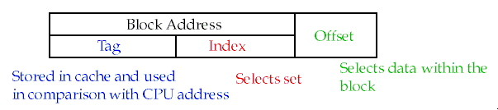
The Format of the Physical Address
Strategy of block Replacement
Random replacement - randomly pick any block
Least-recently used (LRU)
First in,first out(FIFO)-Choose a block from the set which was first came into the cache
Write Strategy
Write-through adv: Read misses don't result in writes, memory hierarchy is consistent and it is simple to implement.
Write back adv: Writes occur at speed of cache and main memory bandwidth is smaller when multiple writes occur to the same block.

Slide 52
Write misses
Write misses
  Write allocate
    The block is loaded into the cache on a miss before anything else occurs.
  Write around (no write allocate)
    The block is only written to main memory
    It is not stored in the cache.
  In general, write-back caches use write-allocate , and write-through caches use write-around .
Average Memory Assess time = hit time + miss time
= hit rate × Cache time + miss rate ×memory time
= 99% × 5 + (1-99%) × 45 =5.5ns

Slide 53
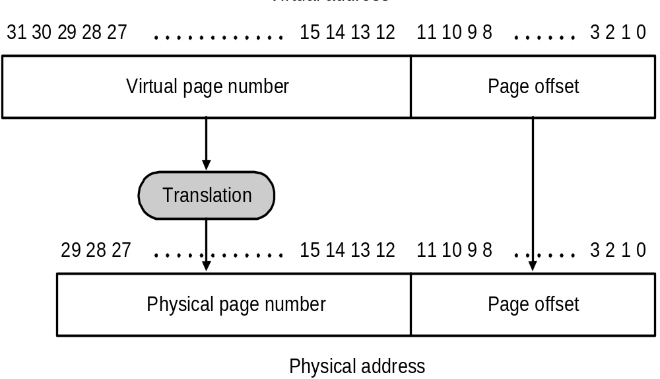
Pages: virtual memory blocks
Page faults: the data is not in memory, retrieve it from disk
  huge miss penalty, thus pages should be fairly large (e.g., 4KB)
  reducing page faults is important (LRU is worth the price)
  can handle the faults in software instead of hardware
  using write-through is too expensive so we use write back

Slide 54
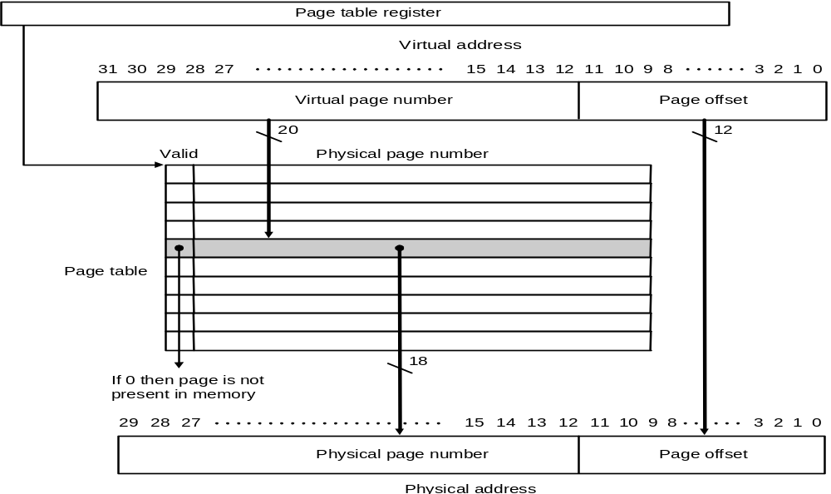
Placing a page and finding it again ----Page Tables, It records all the entries of physical pages and the virtual pages
Virtual memory systems use fully associative mapping method

Slide 55
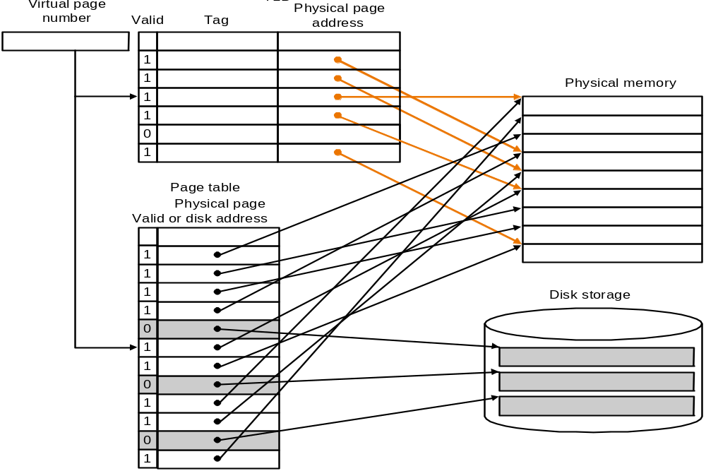
Making Address Translation Fast----TLB
A cache for address translations: translation look aside buffer

Slide 56
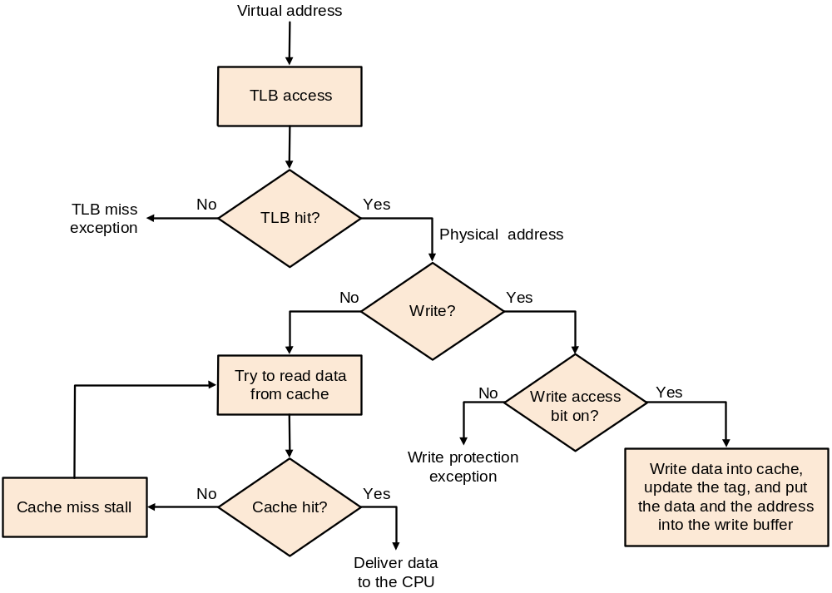
TLBs and caches

Slide 57
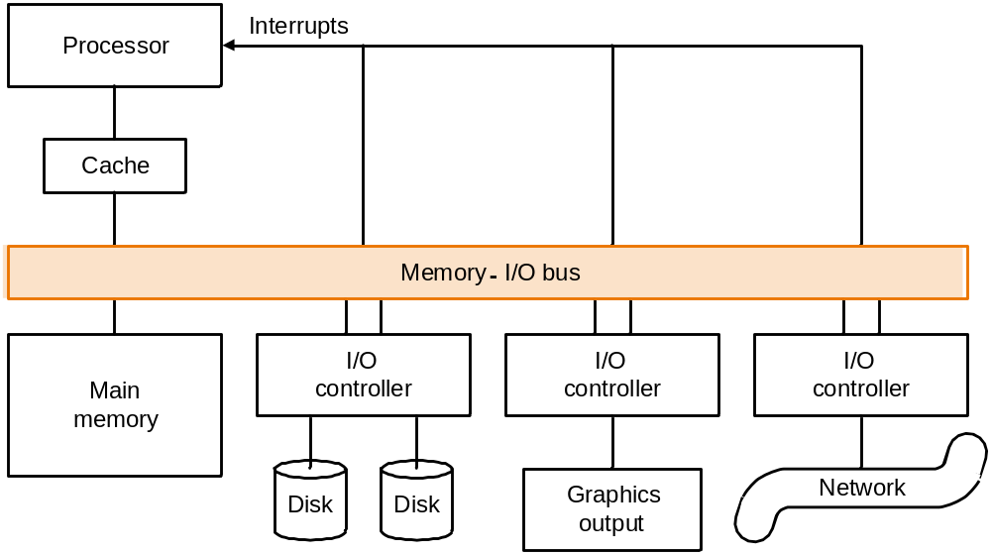
Typical collection of I/O devices

Slide 58
The organization of hard disk
  platters: disk consists of a collection of platters, each of which has two recordable disk surfaces
  tracks: each disk surface is divided into concentric circles
  sectors: each track is in turn divided into sectors, which is the smallest unit that can be read or written

Slide 59
To access data of disk:
  Seek: position read/write head over the proper track
    minimum seek time
    maximum seek time
    average seek time (3 to 14 ms)
  Rotational latency: wait for desired sector
    average latency is the half-way round the disk.
  Transfer: time to transfer a sector (1 KB/sector) function of rotation speed, Transfer rate today’s drives - 30 to 80 MBytes/second
  Disk controller, which control the transfer between the disk and the memory
Access Time = Seek time + Rotational Latency + Transfer time + Controller Time

Slide 60
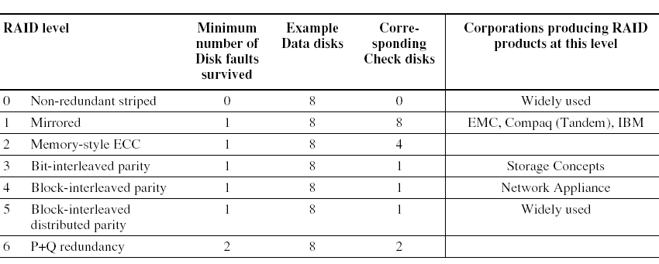
RAID:
Redundant Arrays of Inexpensive Disks
A disk arrays replace larger disk
Error Checking and Correcting

Slide 61
A bus contains two types of lines
  Control lines, which are used to signal requests and
  acknowledgments, and to indicate what types of
  information is on the data lines.
  Data lines, which carry information (e.g., data, addresses, and
  complex commands) between the source and the destination.
Bus transaction
  include two parts: sending the address and receiving or
  sending the data
  two operations
    input: inputting data from the device to memory
    output: outputting data to a device from memory

Slide 62
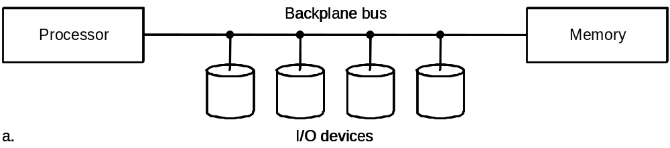
Types of buses:
  processor-memory (short high speed, custom design)
  backplane (high speed, often standardized, e.g., PCI)
  I/O (lengthy, different devices, standardized, e.g., SCSI)
Older PCs often use a single bus for processor-to-memory communication, as well as communication between I/O devices and memory.

Slide 63
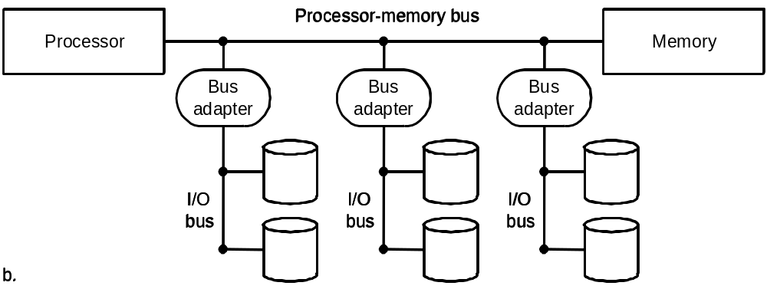
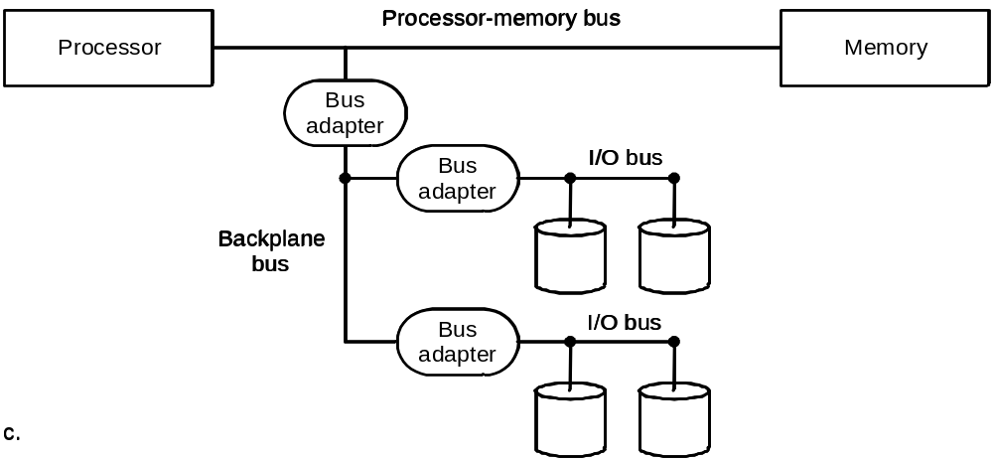
A separate bus is used for processor-memory traffic. The I/O bus use a bus adapter to interface to the processor-memory bus.
A separate bus is used for processor-memory traffic. A small number of backplane buses tap into the processor-memory bus.

Slide 64
Synchronous vs. Asynchronous
  Synchronous bus use a clock and a synchronous protocol,
  fast and small but every device must operate at same rate
  and clock skew requires the bus to be short
  Asynchronous bus don’t use a clock and instead use
  handshaking, used for wide variety of devices
  Our example ,which illustrates how asynchronous buses
  use handshaking, assumes there are three control lines.
    ReadReq: Used to indicate a read request for memory. The address is
    put on the data lines at the same time.
    DataRdy: Used to indicate that data word is now ready on the data lines.
    Ack: Used to acknowledge the ReadReq or the DataRdy signal of the
    other party
Handshaking protocol

Slide 65
Bus Arbitration
  Deciding which bus master gets to use the bus next
  In a bus arbitration scheme, a device wanting to use the
  bus signals a bus request and is later granted the bus.
  four bus arbitration schemes:
    daisy chain arbitration (not very fair)(p670)
    centralized, parallel arbitration (requires an arbiter), e.g., PCI
    self selection, e.g., NuBus used in Macintosh
    collision detection, e.g., Ethernet
Two factors in choosing which device to grant the bus:
  bus priority
  fairness

Slide 66
  Communication with the Processor
  I/O SYTEM DATA TRANSFER CONTROL MODE
  Polling: The processor periodically checks status bit to see if it is time for the next I/O operation.
  Interrupt: When an I/O device wants to notify processor that it has completed some operation or needs attentions, it causes processor to be interrupted.
  DMA (direct memory access): the device controller transfer data directly to or from memory without involving processor.

Slide 67
Designing an I/O system
The general approaches to designing I/O system
  Find the weakest link in the I/O system, which is the component in the I/O path that will constrain the design. Both the workload and configuration limits may dictate where the weakest link is located.
  Configure this component to sustain the required bandwidth.
  Determine the requirements for the rest of the system and configure them to support this bandwidth.

Slide 68
Thank you!
Notes:
1.1 Introduction

